Slide 1

COVID-19
Evaluation of Percentage Probability from Clinical features for a Person to be Infected with COVID-19
Presented By :
Aman Kumar(17025),
Dept. of Mathematics
Indian Institute of Science Education and Research, Bhopal

Slide 2
Corona
First person to have contracted COVID-19 is a 55-year-old individual from Hubei province in China on Nov. 17, 2019.
The first case of COVID-19 in India, which originated from China, was reported on 30 January 2020.
A new study has suggested that the Sars-CoV-2, the virus that causes Covid-19, might have originated from a recombination of coronaviruses in a bat and pangolin. The findings strengthen the theory that pangolins could be the intermediate host for transmission of Sars-CoV-2 to humans.
As of now 85 lakhs confirmed cases of COVID-19 in world and 3.5 lakhs cases in India.
Till now India's response to the virus has been mixed. Lockdown proved to be very effective but it was hampering economy, so lifting of lockdown was a necessity which gave rise to increasing number of cases.
India imposed an early Lockdown in contrast to other countries, so it proved to be very effective and till now have avoided phase 3 transmission.
Researchers are consistently working on the vaccine for this disease and as for now proper testing and isolation is the only key against this disease.
Due to the massive number of possible patients, it is difficult to test each and every person and even a single positive case can lead to the spreading of the virus at a very huge scale.

Slide 3
Previously the approach for allotment of the test was based on the travel history of the person or if the person is suffering from COVID-19 symptoms or if he/she was in contact with an infected person but this is not applicable in the current scenario.
There is limitation of testing kits and cost to test a person for COVID-19 cost around Rs. 4500 in India.
AIM
we have predicted the percent probability of a person for being infected with coronavirus with the help of some basic clinical features of their body by applying various machine learning algorithms.
This prediction can help us to prioritize our testing to the most prone cases of the corona. We can further test less prone cases by dividing them into small groups and mixing their blood samples together.
Thus if a sample tests negative then the whole group of people tests negative and we need not perform any further testing.
Thus our model for probability prediction is highly helpful in targeting a better audience for testing as well as reducing the number of possible tests.

Slide 4
Dataset
We downloaded the original dataset from “Kaggle”.
The original dataset consisted of 5644 rows of patients and 111 columns which consisted of clinical features (eg.​Hematocrit, Hemoglobin,Platelets etc)including patient ID and test results.
Before applying our model to the dataset we cleaned the dataset by removing rows and columns with very less or no information.
Finally, we applied our model with 602 rows of patients and 17 columns which included patient ID and test results.
Then we deal with missing values by marking them as ‘NaN’.
Dividing the dataset into training and test set.
We did feature scaling so as to standardize the independent features in a definite range to handle the large variation in data.
The clinical data were normalized such that their mean is zero and has a unit standard deviation.

Slide 5
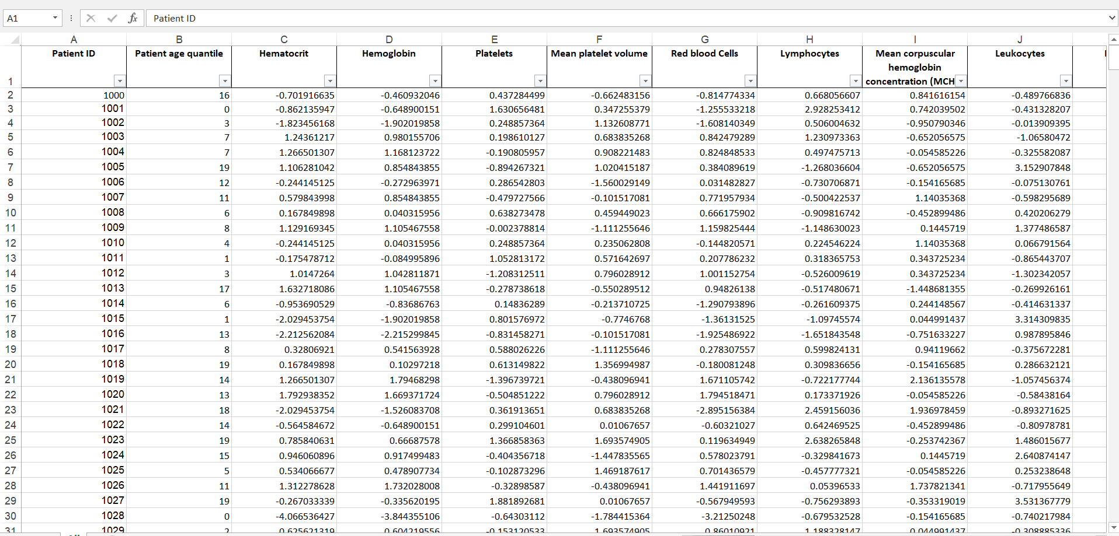

Slide 6



Applying Models
1. Application of Naive Bayes Algorithm
Here we represent each person to be tested( t ) as a set of clinical features associated with them.
Let x and y be the set of positive and negative cases respectively.
Let t be a person to be tested then t = f1 + f 2 + ..... + f n ​where f1, f 2, f n, etc are different clinical features of a person to be tested.
Now calculation of probability for t to be tested positive
Here ‘Naive’ condition is assumed to be true i.e.each clinical feature of t is independent of other clinical features in it. Thus, ​
Now implementing Bayes Theorem, ​
Hence our model is ready for prediction.

Slide 7
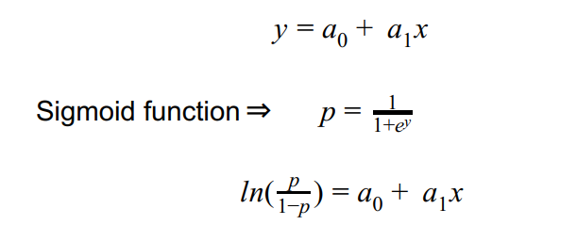
2. Application of Logistic Regression Algorithm
In normal regression, we would have used a function to predict the probability of a person to be tested positively.
But, in logistic regression, the idea is the same but with that function, we combine another function named sigmoid or logistic function.
All the clinical features act as the independent variables and are used to predict the dependent variable which in our case is whether a person is infected with COVID-19 or not.

Slide 8
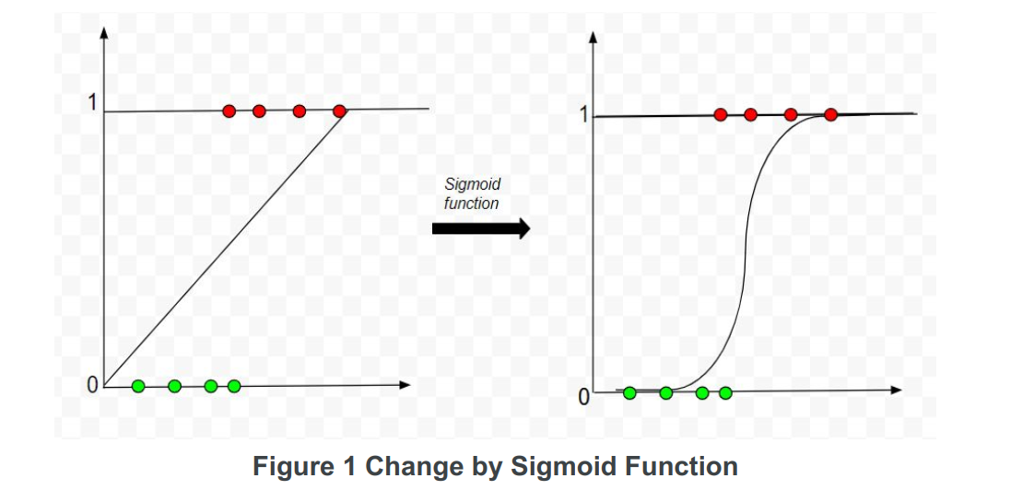
As we can see figure 1 shows the change that occurs after applying the logistic function on the data set and figure 2 shows how the probability threshold works in predicting the percent probability.

Slide 9
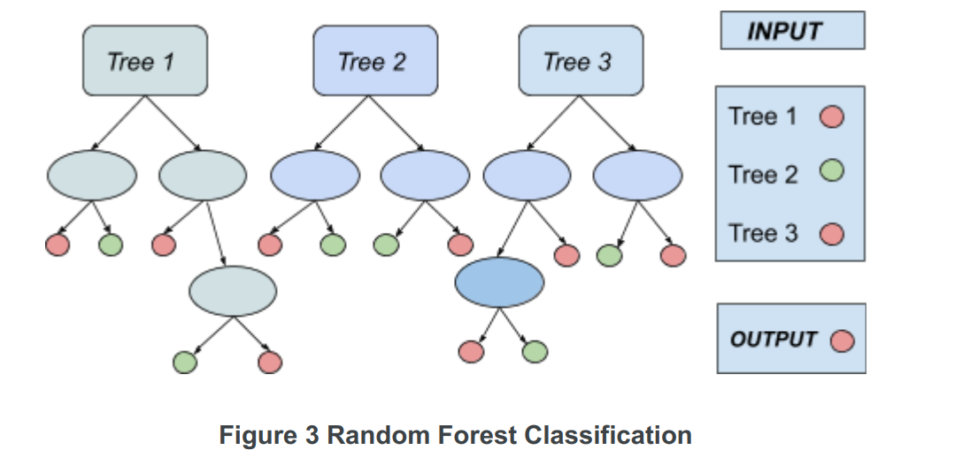
3. Application of Random Forest Algorithm
Random Forest, as the name suggests, consists of many decision trees.
It builds a number of decision trees on the randomly selected data sample.
The number of decision trees can be set in accordance with the dataset we are using for our model.
Then it gets predictions from each tree and by means of majority voting, it selects the decision which gets the majority vote.

Slide 10

4. Application of Support Vector Machine Algorithm
For the prediction of probability through SVM we need to plot the data of each patient in a m dimensional space where m is the number of clinical features used for prediction.
This classifier works by searching the optimal hyper-plane so as to perfectly differentiate the plotted classes in m dimensional space.
Each coordinate is represented as a vector.
Out of many hyper-planes that one is selected which precisely differentiates between positive and negative cases in accordance with a given probability threshold.
The equation for separating hyper-plane,
Where w = Normal to the hyper-plane,
x(i) = i th patient in the training set on which model is to be trained.
Here we choose the hyperplane with a maximum margin so as to minimize the possibility of wrong test detection.

Slide 11
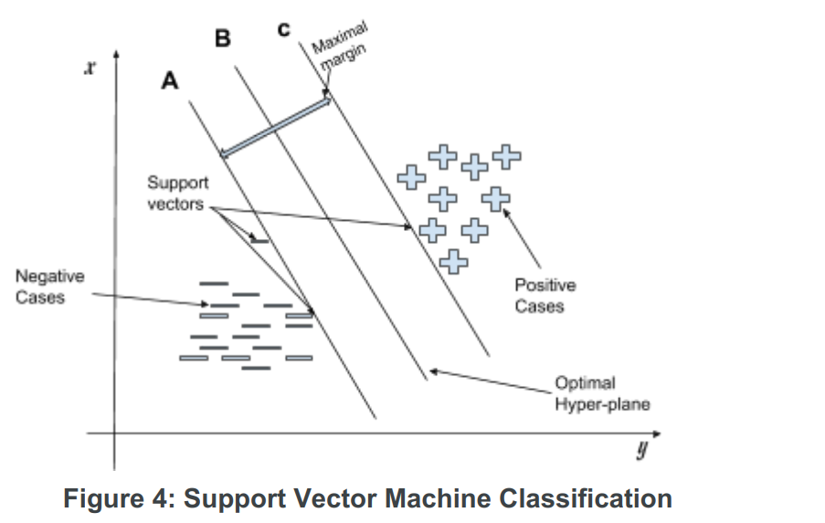

Slide 12
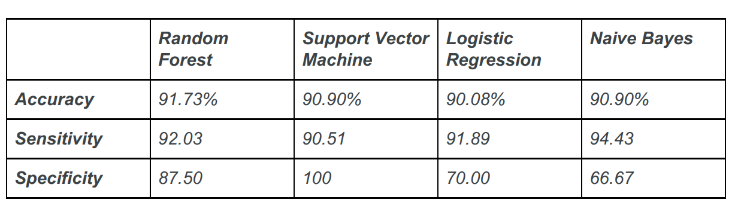
Test and Result
Our model predicts the percent probability of whether a patient is suffering from COVID-19 or not.
This percent probability p can further help us to reduce the number of tests that are to be performed.
The purpose of using percent probability rather than a binary output is that if binary output gives even a single​ False Negative​ can lead to damage on a very large scale as it all started with one patient and now has turned into a pandemic.
On the other hand with the help of percent probability, we never rule out the possibility of​ False Negative ​so there is a surety of no negative impact on practical use.

Slide 13
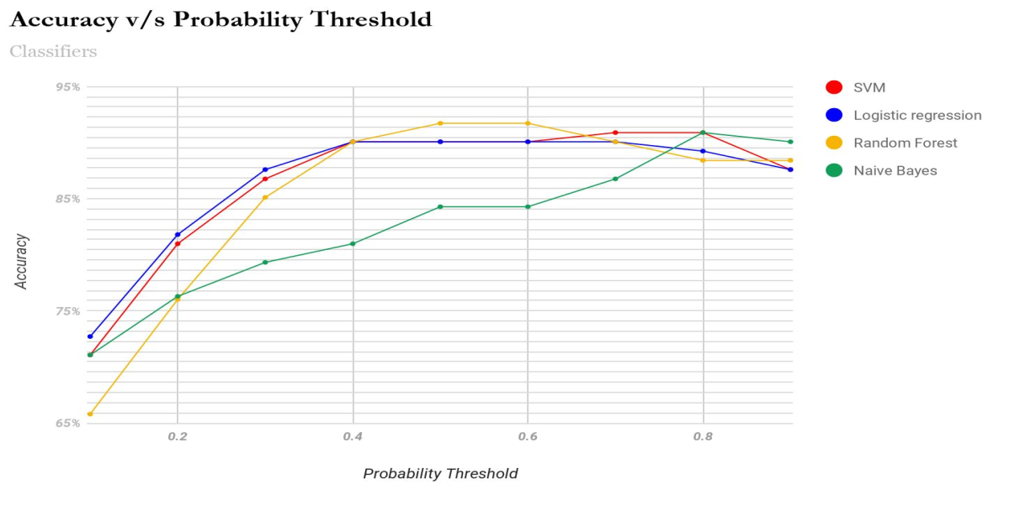
The above graph shows the change of accuracy with respect to different thresholds of probability for different machine learning classifier algorithms.
As it is evident from the above graph that with the increase in the probability threshold, the accuracy increases and reaches a maximum value and then starts decreasing.
This pattern occurs because when the threshold is very low the value of ​False Positives ​is very high in the prediction which leads to low accuracy whereas when the threshold increases the value of ​False Positive ​decreases and accuracy increases.
But as we go on increasing the probability threshold, the value of False Negative ​starts increasing, near the maxima there is a balance between the two values and the accuracy is highest but after that ​False Negative ​increases rapidly thus decreasing the accuracy at that point.

Slide 14
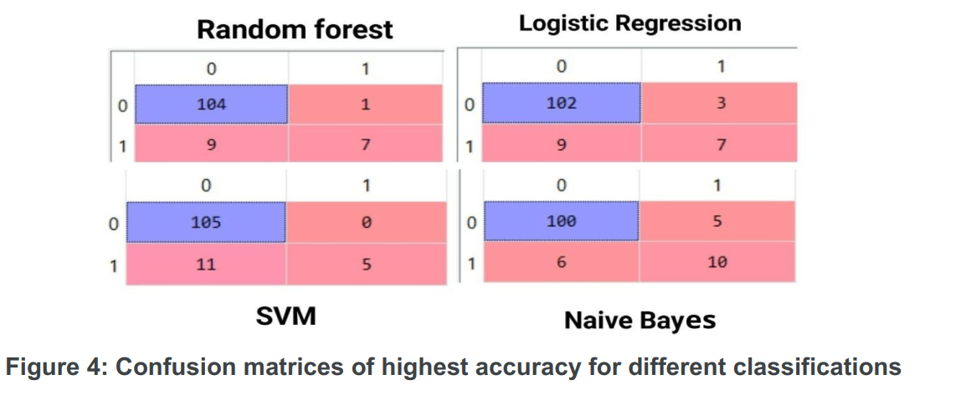
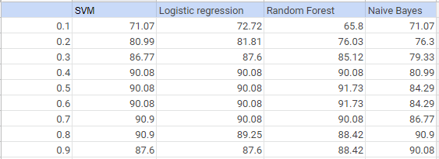

Slide 15
Conclusion
It is so evident from our study that this model could be highly beneficial for large scale testing during this pandemic as testing is the prime key against this disease.
There has been a very limited study to predict the percent probability for a person to be infected with Coronavirus.
Thus our study could be a milestone in this field and could be highly helpful in properly targeting our potential COVID-19 patients and testing them with higher priority.
Also, we have described a method to test persons with lower risks after their identification by mixing their blood samples and testing them collectively such that a minimum number of tests are done.
Different classification models gave different accuracy for the same dataset.
We achieved an accuracy of 90.9% from Naive Bayes and SVM classifiers while 90.8% and 91.73% from Logistic Regression and Random Forest classifiers respectively which can further be improvised when trained on a bigger dataset and with a greater number of clinical features in the dataset.

